Slide 1
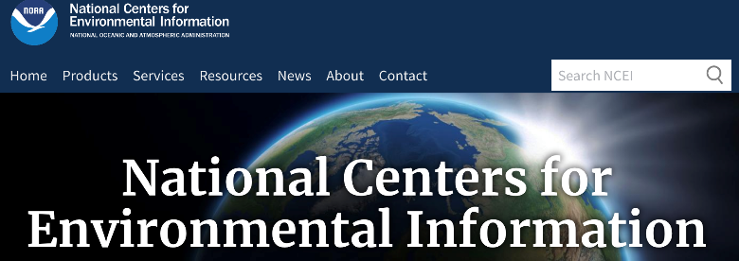


Accessing data: Overview
Many sites provide free geoscience data
in the U.S. and around the world
Given the many types of geoscience data, there are multiple agencies involved - just in the United States.
Image icons for The U.S. NOAA NCEI, European Geosciences Union, and British Geological Survey
Notes:
Images: https://www.ncei.noaa.gov , https://cdn.egu.eu/static/e1e8004/logos/egu_claim_blue_compact.svg , https://www.bgs.ac.uk/images/bgslogo/BGS-Logo-Pos-RGB.svg

Slide 2
Accessing data: Links
Geosciences data sources
weather / climate data sets
U.S. federal data; data hubs
Geological - U.S., U.K.; quake; One
U.S. Department of the Interior
NASA; Unidata; EGU; JpGU; AU
NCEI - Environmental Information
NOAA climate, space, drought, oceans, marine, water, big data
Nature science data; population
Weather grid data – NCAR; world
European ECMWF reanalyses
Marine Geoscience Data System
Climate Model Intercomparison; Extreme indices; IRI; world
Google Earth engine; Amazon AWS
NOAA hurricanes, climate, forecast data, paleoclimate, radar, satellite, coasts, digital forecast data, severe

